Slide 1
Spring Boot Framework
P-000

Slide 2
Java Input with Scanner
Spring Boot is a Java framework that makes it easier to create and run Java applications. It simplifies the configuration and setup process, allowing developers to focus more on writing code for their applications.
Advantages
- It allows to avoid heavy configuration of XML which is present in spring
- It provides easy maintenance and creation of REST end points (Urls for CRUDE operations)
- It includes embedded Tomcat-servers (to host the applications). Deployment is very easy, war and jar file can be easily deployed in the tomcat server
- Microservice Based Architecture
-
Spring Boot
Spring
*REST endpoints, or Representational State Transfer endpoints, are specific URLs (Uniform Resource Locators) that are part of a web service or web application. These endpoints correspond to resources (such as data or functionality) that the service or application provides access to.

Slide 3
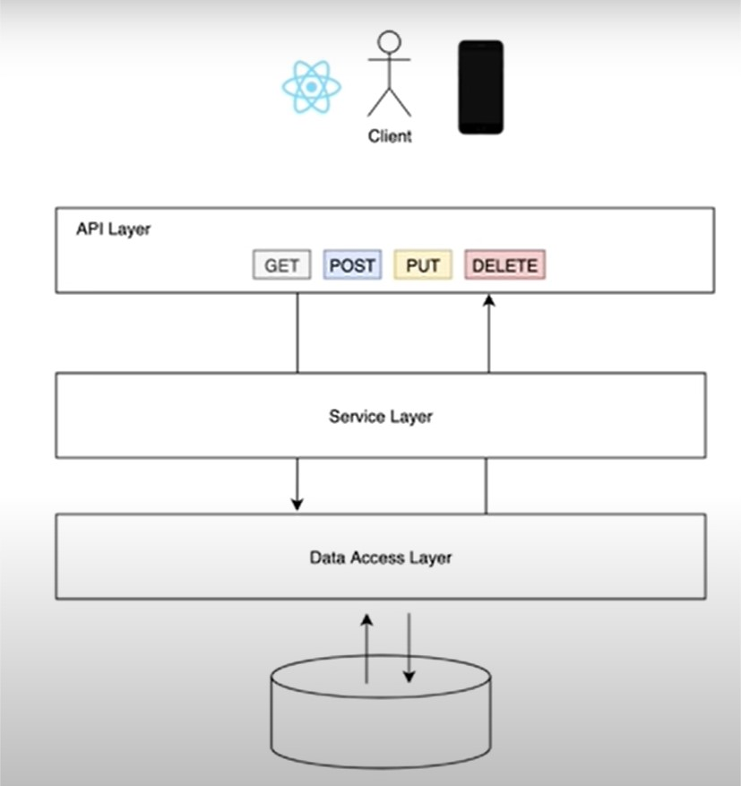
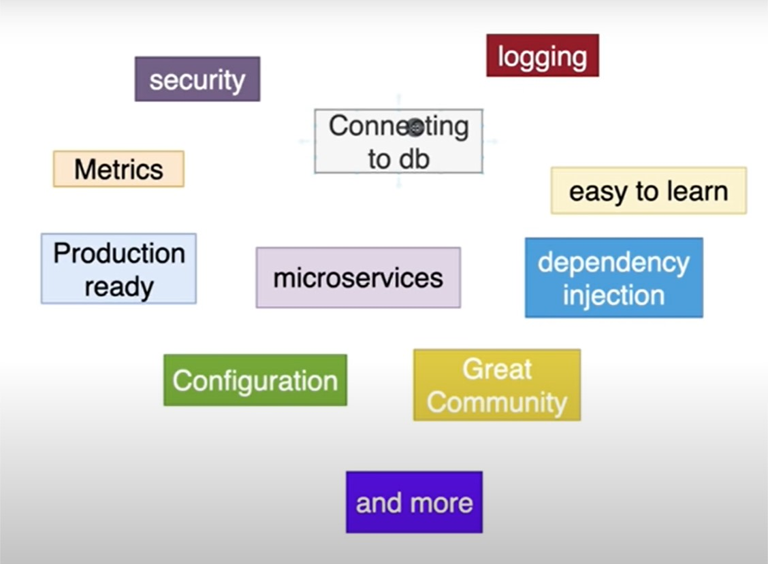
How and Why Spring Boot Framework
Front End
Business Logic
Database

Slide 4
Step 1: Spring Initializer
Go to https://start.spring.io/ to set up the information for a project
As dependencies installing
Spring Web
Spring Data JPA
PostGRE SQL Driver
A Snapshot of the configuration:
(https://start.spring.io/#!type=maven-project&language=java&platformVersion=3.2.5&packaging=jar&jvmVersion=17&groupId=com.example&artifactId=demo&name=demo&description=Demo%20project%20for%20Spring%20Boot&packageName=com.example.demo&dependencies=web,data-jpa,postgresql)

